Slide 1
Sor Juana Inés de La Cruz: From Prose and Irony to Argumentative Philosophy
Nadia Ruiz, PhD
Dualist Speaker Series-Stanford University

Slide 2
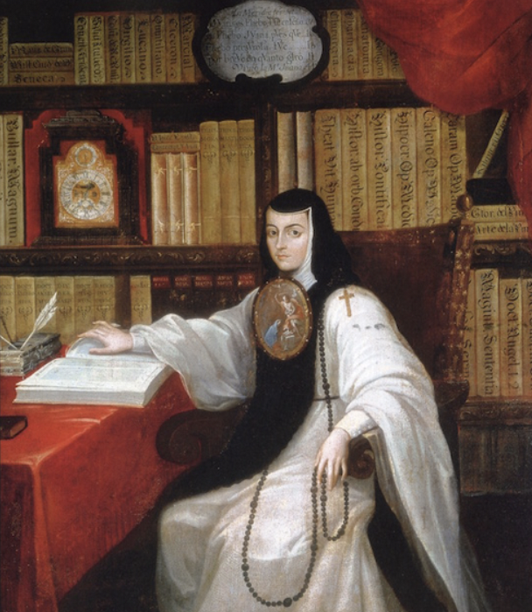
Sor Juana Inés de la Cruz (1648?-1695)
Born in San Miguel de Nepantla (South of Mexico City).
Learn to read at age 3.
At age 8-10 she is sent to live with her aunt in Mexico City.
In 1664 Sor Juana is taken to the Viceregal Court. She met the Marquis de Mancera, and his wife, Vicereine Leonor Carreto, who took Sor Juana as a lady-in-waiting of the Viceregal Court.
In 1667 entered the austere convent of “Orden de las Carmelitas Descalzas de San José.” Left after three months.
In 1668 entered the convent of “Orden de San Jerónimo”, where she remains until her death in 1695.
Covent is wealthy and has a library of over 4,000 volumes, collects musical and scientific instruments, and receives guests at intellectual gatherings.
Primero Sueño (First Dream); Hombres Necios (You Foolish Men); Respuesta a Sor Filotea (Response to Sor Filotea).

Slide 3
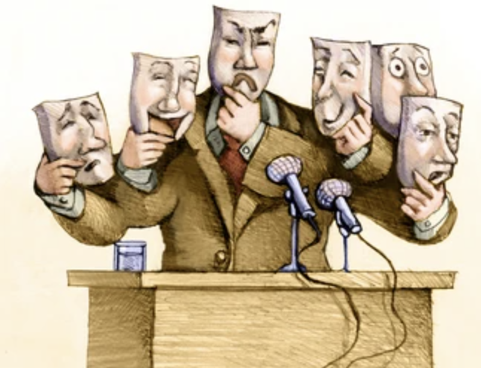
Hombres Necios (Foolish Man)
Philosophical Satire.
What is satire?
Is it an appropriate method to do philosophy?
What did Sor Juana attempt to argue for?
Notes:
Satire: the use of humor, irony, exaggeration, or ridicule to expose and criticize an individual, group, or institution

Slide 5
Sor Juana Said It First!!
Sor Juana’s Prose:
Satire (ridiculed Mexican patriarchy-macho culture)
Double bind
All the options result in penalties.
There is no way for women to find a happy medium.
Marilyn Frye (The Politics of Reality)
Double-bind is a fundamental form of being oppressed as women.
If a women dress up, she is advertising her sexual availability.
If a woman does not dress up, she has let herself go.
If a man does not help with household duties? It is ok because he is working to provide for his family (poor him, he is tired).
If a man does help with household duties? It is ok. He is a great husband and father (a hero).
Who does not love a man who does the dishes, vacuums, and cleans up their space?
Women’s options never lead to a happy middle. They always end in penalty, censure, or deprivation.

Slide 6
Respuesta a Sor Filotea (Response to Sor Filotea)
Who is Sor Filotea?
Bishop of Puebla, Manuel Fernandez de Santa Cruz.
Bishop was her “friend and advisor” and normally wrote to her under the pseudonym “Sor Filotea.”
What did Sor Filotea say that angered Sor Juana?
Questioned and demanded that Sor Juana stop publishing.
He argued that he was in favor of women’s education at a high level but thought to use it in public was a form of sinful pride.

Slide 7
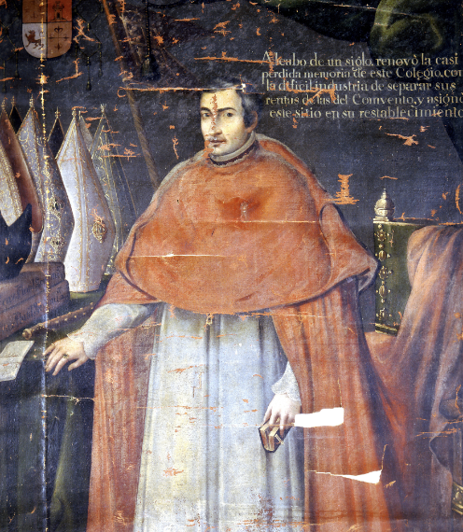
The Answer To Sor Filotea
Sor Juana wrote a letter (carta atenagórica) in which she criticized Portuguese Jesuit Antonio de Vieira.
Bishop Manuel Fernandez published the letter in 1690 without her consent and signed as Sor Filotea
In the published version of the letter Bishop accused her of:
Not devoting her talents to writing theology, e.g., Santa Teresa de Avila.
Writing literary work.
Her writing is a bad example for other educated women.
Irony
What is it?
How Sor Juana used it?
Notes:
a state of affairs or an event that seems deliberately contrary to what one expects and is often amusing as a resul

Slide 8
Response Concerning Holy Writing
Argument from fear:
Has nothing to do with a lack of desire, but instead, is fear of doing it.
Due to my sex, age, and lack of education makes me an unworthy (and ill-equipped) candidate to study the Bible.
So, I can make a wrong interpretation on matters of the Holy script and the Holy Office would punish me for corrupting peoples’ souls.
Contrary to this, if I make a mistake on matters of secular topics, the punishment is laughter and criticism.
Also, since I am a woman, the burden of being right is less.
Argument from learning beyond theology:
I confess attempts of writing about the Holy scripts, but…
How to understand theology without learning about metaphysics first.
How to write eloquently without having mastered logic and rhetoric.

Slide 9
Justification for literary writing
Argument from God’s gift:
Writing is not the result of my own volition.
I have been asked (and compelled) to do it.
Cannot contradict God’s will––i.e., the gift of love for truth.
So, writing is a natural impulse for the love of truth, which obeys God’s will.
Argument from Philosophy Kitchen:
“I say that if Aristotle had cooked, he would have written a great deal more”
When forbidden to stop learning (books taken away), the world becomes my classroom.
Empirical observations lead to scientific and creative writing.

Slide 10
Plea for Women’s right to education
Need for a classroom.
Also, it is a self-justification for not having written more.
Sor Juana’s identity as a counterexample for arguments that intellectual activity is not a feature of women.
Also, the many female figures found throughout history.
Why is Sor Juana’s argument different from Mary Wollstonecraft’s argument?
Older women, who have been given the right to an education, can teach younger girls.
What is her justification?

Slide 11
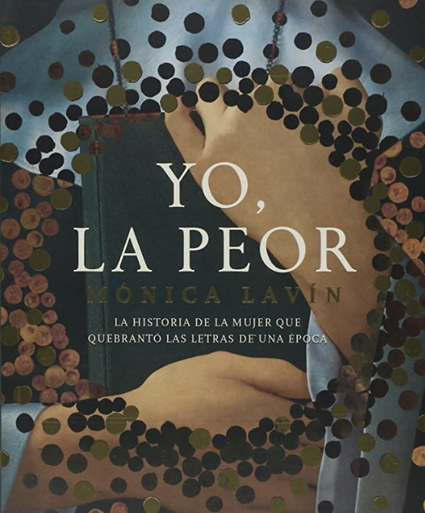
Conclusions:
Sor Juana thinks that to engage in moral (divine) activity; one must master other sciences first.
Use of irony and sarcasm to justify her intelligence.
Illustrates that women’s lack of education is not due to women’s nature but an institutionalized consequence.

